Slide 1
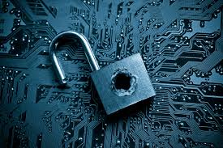
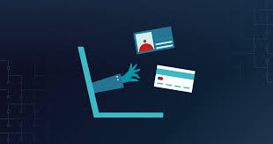
Data breach
Sailor moon

Slide 2
Introduction
Data breach refers to the deliberate or unintentional release of secure or private information into an untrusted environment.
Other terms include unintentional information breach and data breach.
It is a security conflict in which sensitive, protected or confidential data is copied, transmitted, viewed, stolen or used by unauthorized individuals.
It may involve financial information, personal health information (PHI), personally identifiable information (PII), company trade secrets or intellectual property.
It can cause very high loses, including direct costs and indirect costs.

Slide 3

Types of Data Breach
Denial-of-Service
A cyber-attack
the perpetrator wants to make a machine or network resource unavailable
It is accomplished by flooding the target machine
It occurs when a website is overwhelmed with request
This attack is typically done to large company.

Slide 4
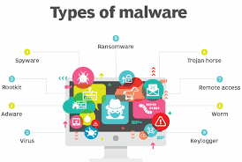
Types of Data Breach
Malware
Malicious software
Consists of code developed by cyberattacks
Cause damage to data and systems.
Worm, Trojan etc.
Delivered over email via a link or executable file.
e.g. Hospital

Slide 5
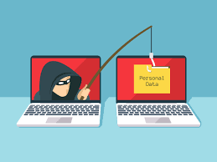
Types of Data Breach
Phishing
A cyber crime.
Most common: website phishing
contacted by email, telephone or text message
as a legitimate institution
cause in identity theft and financial loss.
There is also ‘vishing’ (voice phishing) and ‘smishing’ (SMS phishing).
Compromise the safety of any sensitive information.

Slide 6
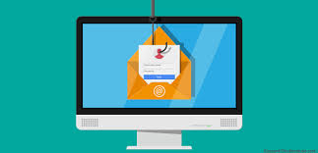
Types of Data Breach
Common features of phishing emails
Attachments
Unusual sender
Hyperlinks

Slide 7
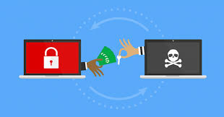
Types of Data Breach
Ransomware
Business that need access to time sensitive data (e.g. hospital).
Require a fee to be paid in order for system to work again.
Gains control of system and locks it from use through ransomware.
Scareware
No guarantee user can be fully access again.
fake antivirus software.

Slide 8
Why data breach happens
Human error
Sending sensitive information to the wrong recipient
The use of weak passwords
Phishing
Malware
It is continually evolving with the assistance of hackers, making in undetectable by antivirus program.
Hacker can access the company’s database to obtain the important details they need.
Hacker have made minor modification to existing malware programs to make them unrecognizable by anti-virus programs.

Slide 9
Why data breach happens
Physical Theft
The theft of paperwork or any stolen device (e.g. laptop, tablets etc.)
Card skimming
Criminal Hacking
It is usually associated with computer coding.
The most common criminal hacking technique involves stolen credentials.
Scammers can buy credentials on the dark web.

Slide 10
Why data breach happens
Back doors
Spyware
Ransomware
Malicious insiders
The person who intends to access and share data in order to cause harm.
They may have legal authorization to use the system and data, but their purpose is to use the information in a malicious way.

Slide 11
Why data breach happens
They can
Affect external website and cause public damage to your brand
Prevent the normal operation of the system
Steal or sell trade secrets or intellectual property (IP)
Install malicious software for its own purposes

Slide 12
Consequences of data breach
User thoughts are easily trapped
Privacy leakage can also engulf users’ minds, change their three views, and ultimately lead the entire society to develop in a well-designed direction.
e.g. the well-known Facebook user privacy leak case

Slide 13
Consequences of data breach
Threaten the personal property of the user
It is directly sold for illegal gains or used by criminals to engage in criminal activities.
Criminals collect people’s leaked privacy and conduct precise crimes after screening and analyzing user characteristics.
Threaten the security of the country and the company
The harm to companies and country is huge.
Criminals collect some important information from the opposing company and sell the information to their competitors.
e.g. the information leakage incident of Turkey’s 50 million residents

Slide 14
How to detect data breach
Stay informed
Latest cybercrime news
Cybersecurity trends
Surround with right people
Best security organization
Improve detection and response

Slide 15
How to detect data breach
Get a data breach detection solution
Investing in data breach prevention solutions.
Overcome attack
Train your users
take benefit of user through phishing.
Taught about the importance of security.

Slide 16
How to prevent data breach
Reduce the amount of information you provide
Use aliases whenever possible
Research the company’s safety record before doing business with the company
Use end-to-end encryption
Use strong passwords
Data backup and recovery
Create and update programs
Establish rights security techniques and conclusions

Slide 17
Examples of data breach
Facebook
Marriot Starwood Hotel
Newegg
Aadhaar
Exactis

Slide 18
Thank you!

